Slide 1
Arbitrage By Pairs Trading
Actions: long, short, close, hold
State:
- 7 spread: very low, low, below mean, mean, above mean, high, very high
- 3 position: long, short, closed
- 7 * 3 = 21 states
Transition: based on the current position and z-score
Reward:
Ao Li

Slide 2
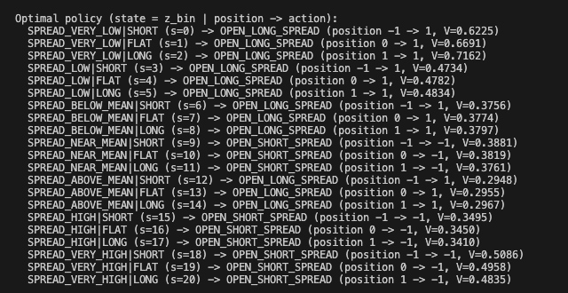
Result
Make Sense
If spread is near mean, action should be close position intuitively.
Maybe the definition of action should be more specific.
Make Sense
Ao Li

Slide 3
Q-Learning
Actions: position change, Δ ∈ {-2Q, ..., 2Q}, number of actions is 4Q + 1
State: number of positions is ∈ {-Q, ..., Q}, number of z_bin is 7, so 7 * (2Q+1)
Transition: based on inventory of position and current state
Reward:

Slide 4
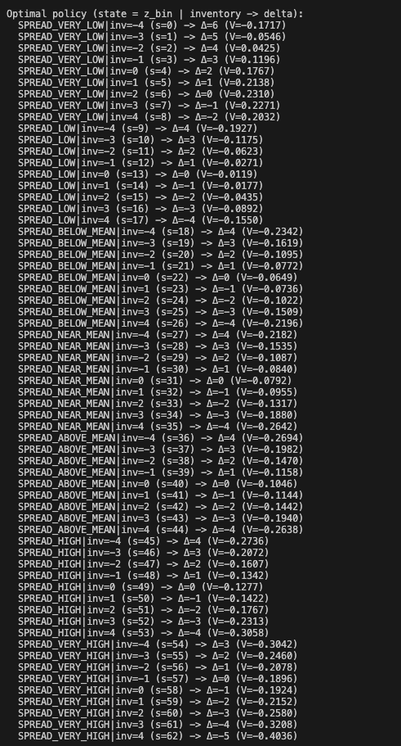
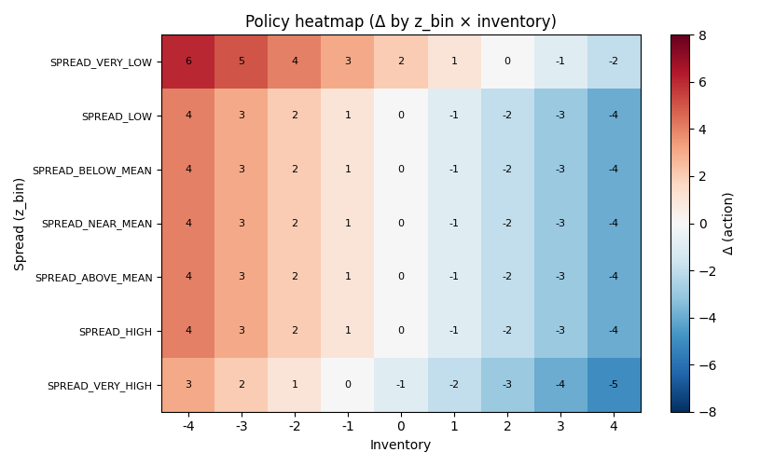
Result

